Slide 1
GPU Programming and CUDA
Sathish Vadhiyar
Parallel Programming

Slide 2
GPU
Graphical Processing Unit
A single GPU consists of large number of cores – hundreds of cores.
Whereas a single CPU can consist of 2, 4, 8 or 12 cores
Cores? – Processing units in a chip sharing at least the memory and L1 cache

Slide 3
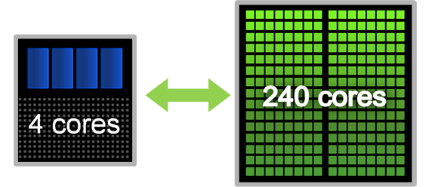
GPU and CPU
Typically GPU and CPU coexist in a heterogeneous setting
“Less” computationally intensive part runs on CPU (coarse-grained parallelism), and more intensive parts run on GPU (fine-grained parallelism)
NVIDIA’s GPU architecture is called CUDA (Compute Unified Device Architecture) architecture, accompanied by CUDA programming model, and CUDA C language

Slide 4
Example: SERC system
SERC system had 4 nodes
Each node has 16 CPU cores arranged as four quad cores
Each node connected to a Tesla S1070 GPU system

Slide 5
Tesla S1070
Each Tesla S1070 system has 4 Tesla GPUs (T10 processors) in the system
The system connected to one or two host systems via high speed interconnects
Each GPU has 240 GPU cores. Hence a total of about 960 cores
Frequency of processor cores – 1.296 to 1.44 GHz
Memory – 16 GB total, 4 GB per GPU

Slide 6
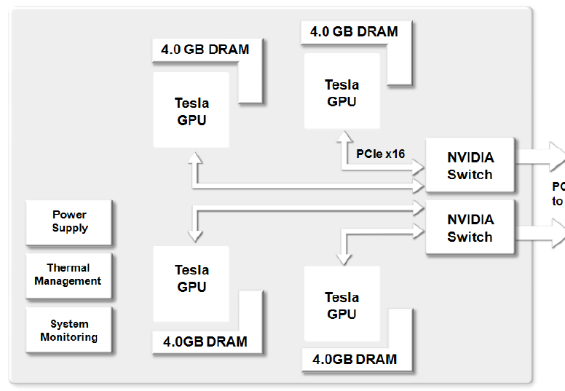
Tesla S1070 Architecture

Slide 7
Tesla T10
240 streaming processors/cores (SPs) organized as 30 streaming multiprocessors (SMs) in 10 independent processing units called Texture Processors/Clusters (TPCs)
A TPC consists of 3 SMs; A SM consists of 8 SPs
Collection of TPCs is called Streaming Processor Arrays (SPAs)

Slide 8
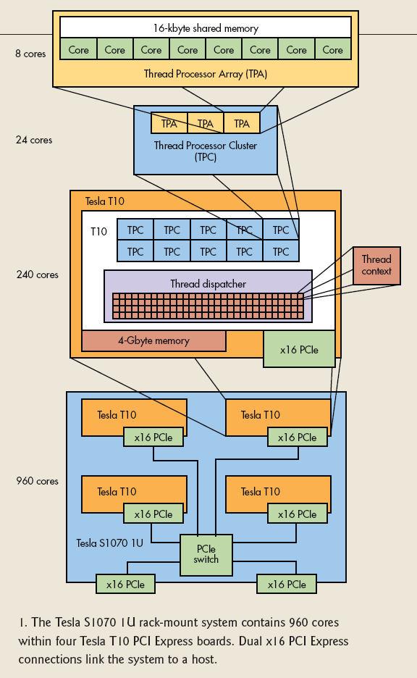

Tesla S1070 Architecture Details

Slide 9
Hierarchical Parallelism
Parallel computations arranged as grids
One grid executes after another
Grid consists of blocks
Blocks assigned to SM. A single block assigned to a single SM. Multiple blocks can be assigned to a SM.
Block consists of elements
Elements computed by threads

Slide 10
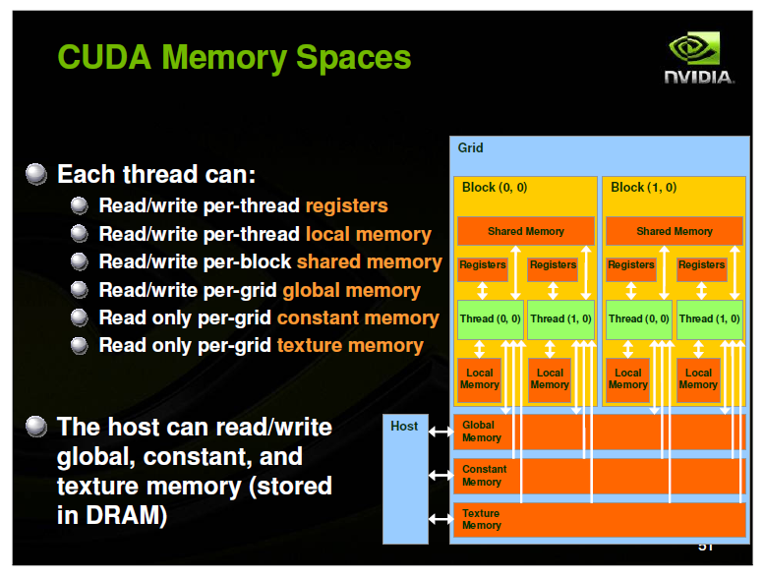

Slide 11
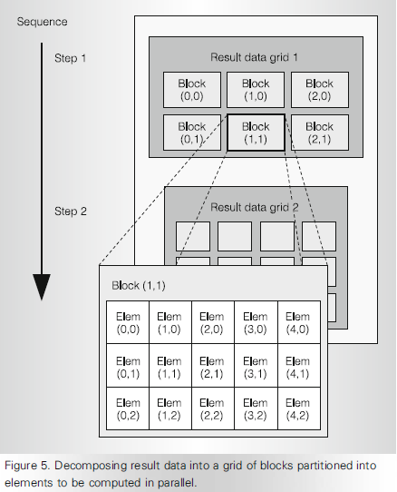
Hierarchical Parallelism

Slide 12
Thread Blocks
Thread block – an array of concurrent threads that execute the same program and can cooperate to compute the result
Consists of 1 to 512 threads
Has shape and dimensions (1d, 2d or 3d) for threads
A thread ID has corresponding 1,2 or 3d indices
Each SM executes up to eight thread blocks concurrently
Threads of a thread block share memory

Slide 13
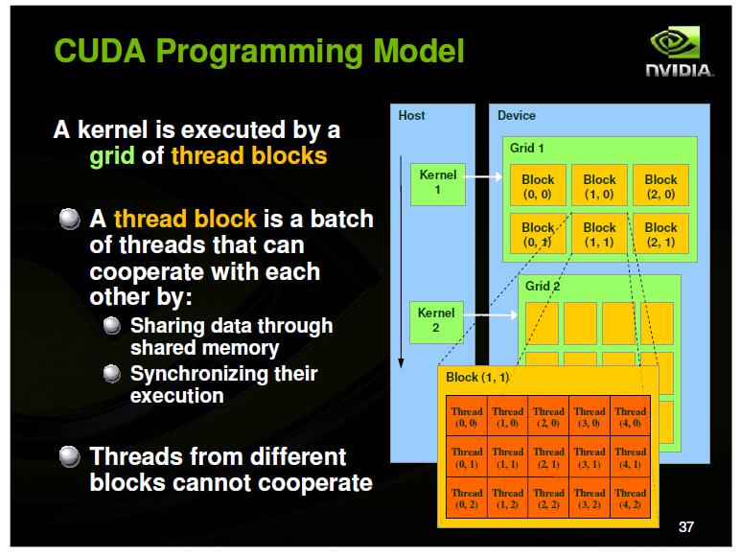

Slide 14
CUDA Programming Language
Programming language for threaded parallelism for GPUs
Minimal extension of C
A serial program that calls parallel kernels
Serial code executes on CPU
Parallel kernels executed across a set of parallel threads on the GPU
Programmer organizes threads into a hierarchy of thread blocks and grids

Slide 15
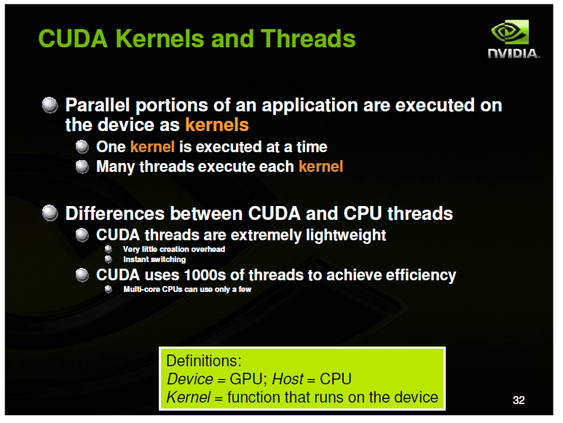

Slide 16
CUDA C
Built-in variables:
  threadIdx.{x,y,z} – thread ID within a block
  blockIDx.{x,y,z} – block ID within a grid
  blockDim.{x,y,z} – number of threads within a block
  gridDim.{x,y,z} – number of blocks within a grid
kernel<<<nBlocks,nThreads>>>(args)
  Invokes a parallel kernel function on a grid of nBlocks where each block instantiates nThreads concurrent threads

Slide 17
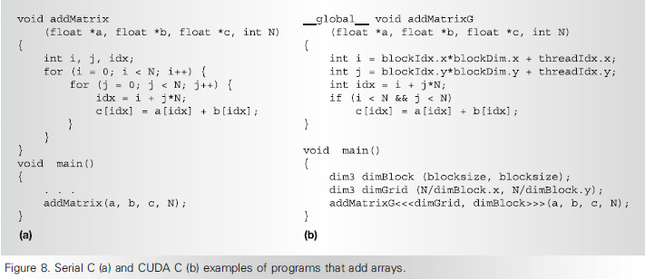
Example: Summing Up
kernel function
grid of kernels

Slide 18
General CUDA Steps
Copy data from CPU to GPU
Compute on GPU
Copy data back from GPU to CPU
By default, execution on host doesn’t wait for kernel to finish
General rules:
  Minimize data transfer between CPU & GPU
  Maximize number of threads on GPU

Slide 19
CUDA Elements
cudaMalloc – for allocating memory in device
cudaMemCopy – for copying data to allocated memory from host to device, and from device to host
cudaFree – freeing allocated memory
void syncthreads__() – synchronizing all threads in a block like barrier

Slide 20
EXAMPLE 2: REDUCTION

Slide 21
Example: Reduction
Tree based approach used within each thread block
In this case, partial results need to be communicated across thread blocks
Hence, global synchronization needed across thread blocks

Slide 22
Reduction
But CUDA does not have global synchronization –
  expensive to build in hardware for large number of GPU cores
Solution
  Decompose into multiple kernels
  Kernel launch serves as a global synchronization point

Slide 23
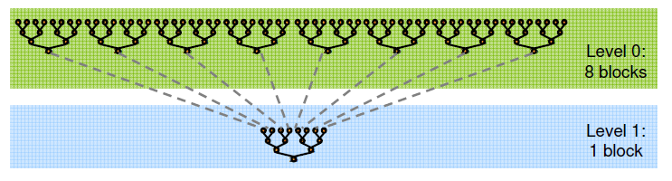
Illustration

Slide 24
Host Code
int main(){
int* h_idata, h_odata; /* host data*/
Int *d_idata, d_odata; /* device data*/
/* copying inputs to device memory */
cudaMemcpy(d_idata, h_idata, bytes, cudaMemcpyHostToDevice) ;
cudaMemcpy(d_odata, h_idata, numBlocks*sizeof(int), cudaMemcpyHostToDevice) ;
int numThreads = (n < maxThreads) ? n : maxThreads;
int numBlocks = n / numThreads;
dim3 dimBlock(numThreads, 1, 1); dim3 dimGrid(numBlocks, 1, 1);
reduce<<< dimGrid, dimBlock >>>(d_idata, d_odata);

Slide 25
Host Code
int s=numBlocks;
while(s > 1) {
numThreads = (s< maxThreads) ? s : maxThreads; numBlocks = s / numThreads;
dimBlock(numThreads, 1, 1); dimGrid(numBlocks, 1, 1);
reduce<<< dimGrid, dimBlock, smemSize >>>(d_idata, d_odata);
s = s / numThreads;
}
}

Slide 26
Device Code
__global__ void reduce(int *g_idata, int *g_odata)
{
extern __shared__ int sdata[];
// load shared mem
unsigned int tid = threadIdx.x;
unsigned int i = blockIdx.x*blockDim.x + threadIdx.x;
sdata[tid] = g_idata[i];
__syncthreads();
// do reduction in shared mem
for(unsigned int s=1; s < blockDim.x; s *= 2) {
if ((tid % (2*s)) == 0)
sdata[tid] += sdata[tid + s];
__syncthreads();
}
// write result for this block to global mem
if (tid == 0) g_odata[blockIdx.x] = sdata[0];
}

Slide 27
EXAMPLE 3: MATRIX MULTIPLICATION

Slide 28
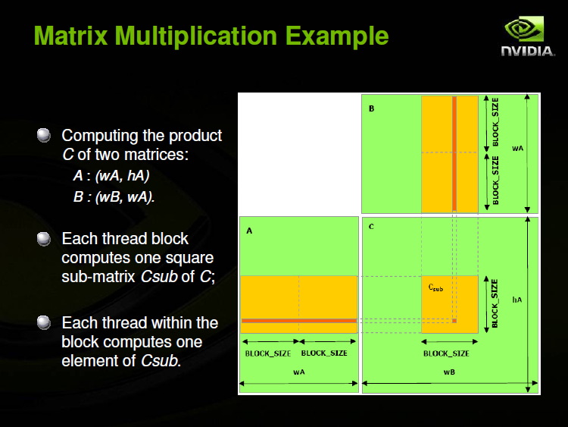

Slide 29
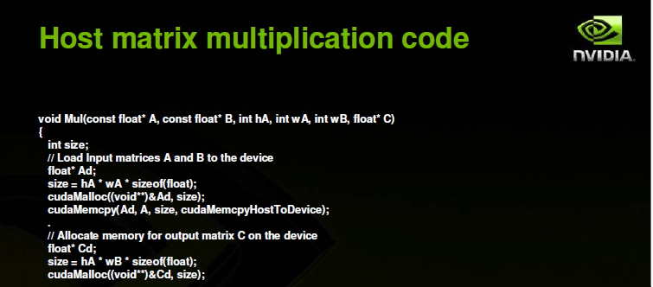
Example 4: Matrix Multiplication

Slide 30
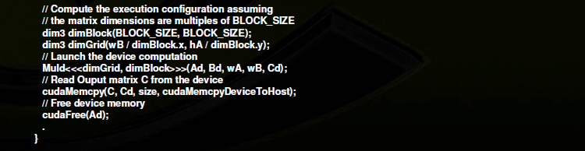
Example 4

Slide 31
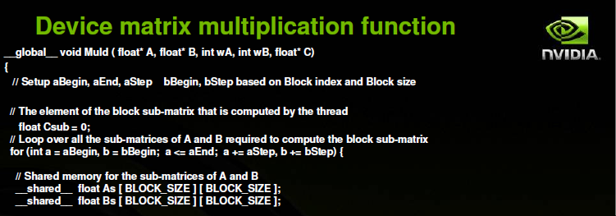
Example 4

Slide 32
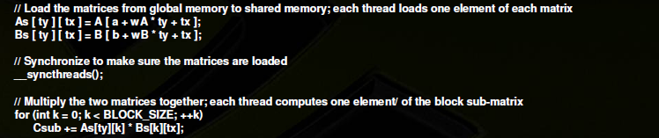
Example 4

Slide 33
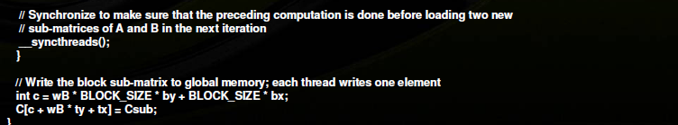
Example 4

Slide 34
For more information…
CUDA SDK code samples – NVIDIA - http://www.nvidia.com/object/cuda_get_samples.html

